Slide 1
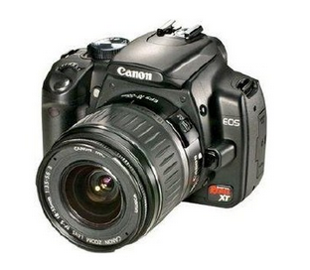
Camera model
By yaoli
2016 11 22

Slide 2
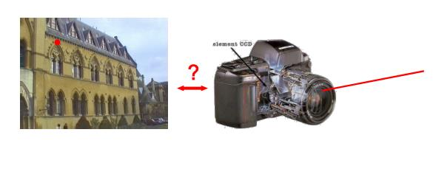
relation between pixels and rays in space

Slide 3
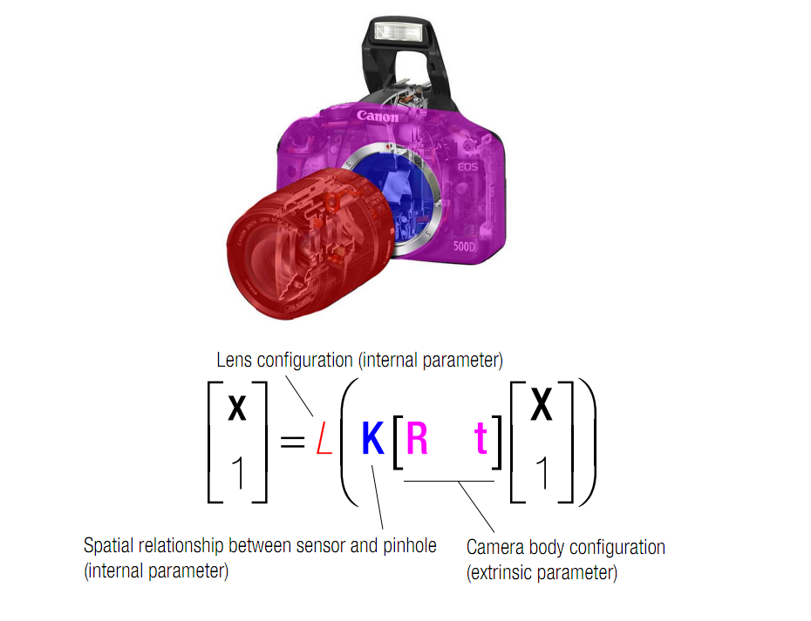

Slide 4
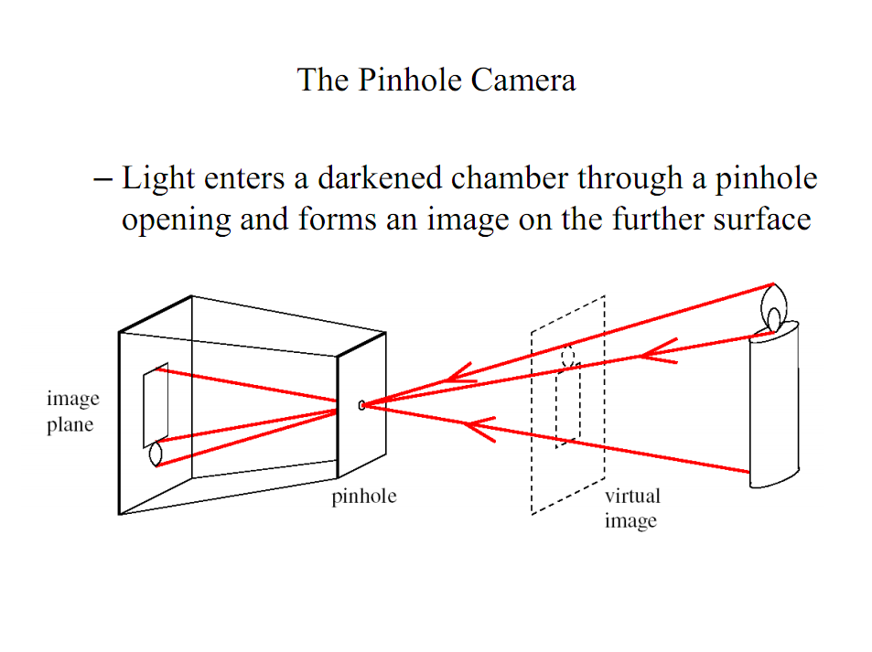

Slide 5
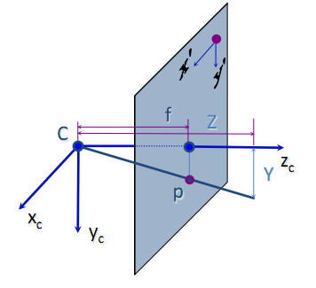
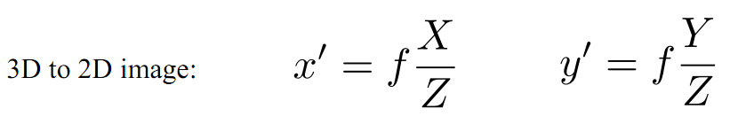
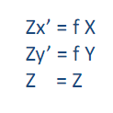
Pinhole camera model
Projection equation:
Notes:
图像坐标系与相机坐标系的转换

Slide 6
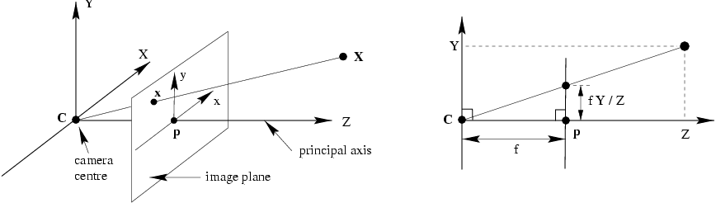
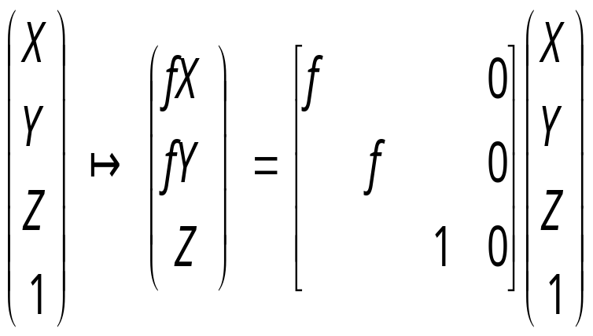
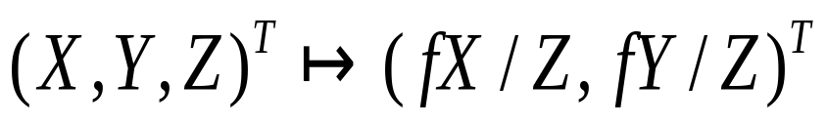
Pinhole camera model
Pinhole camera geometry. C is the camera centre and p the principal point. The camera
centre is here placed at the coordinate origin. Note the image plane is placed in front of the camera centre.

Slide 7
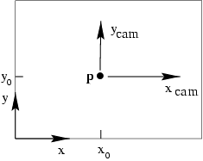
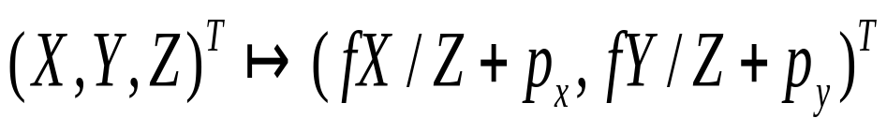
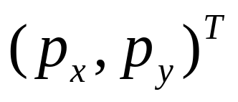
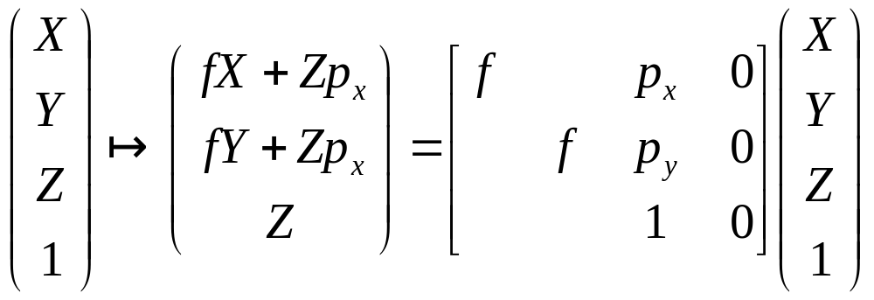
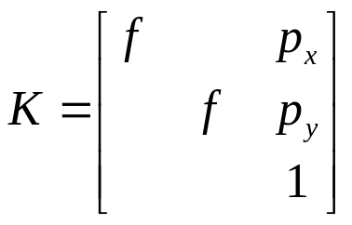
Principal point offset
Image (x, y) and camera (xcam, ycam) coordinate systems.
principal point:
calibration matrix

Slide 8
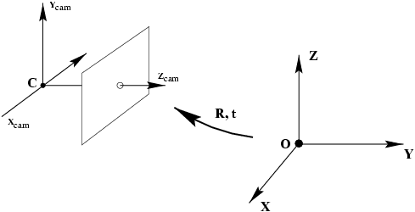
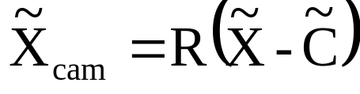
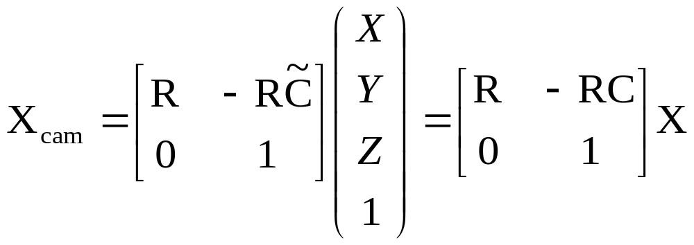
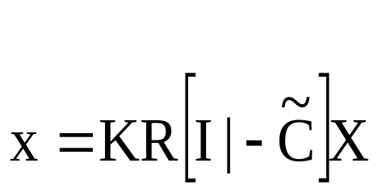
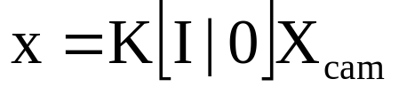

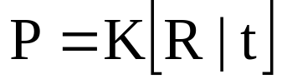
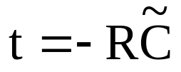
Camera rotation and translation
The Euclidean transformation between the world and camera coordinate frames

Slide 9
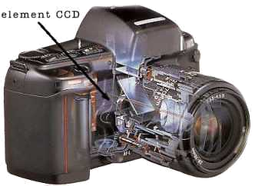
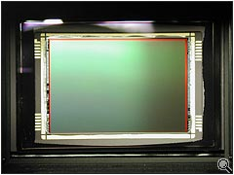
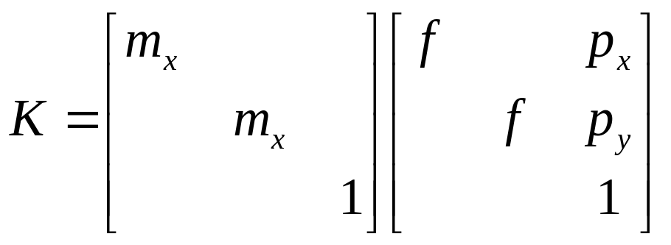
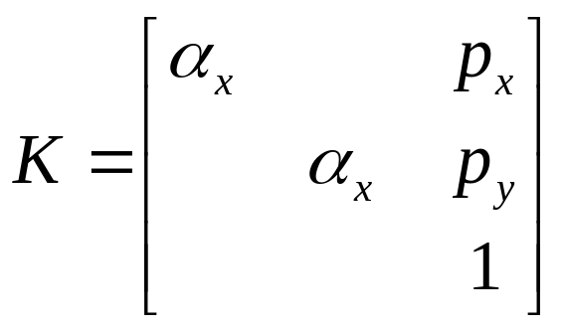
CCD camera

Slide 10
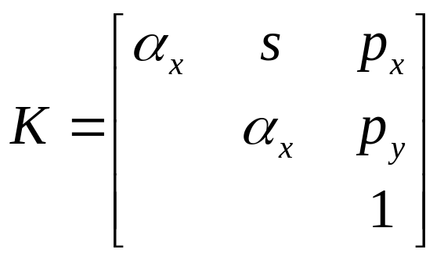
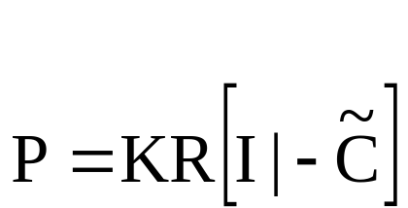
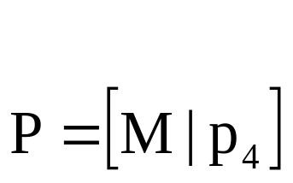
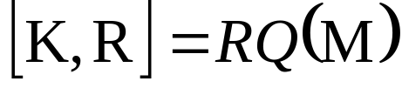
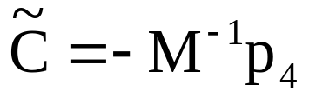
Finite projective camera
11 dof (5+3+3)
non-singular
decompose P in K,R,C?
{finite cameras}={P_{4x3} | det M≠0}
If rank P=3, but rank M<3, then cam at infinity

Slide 11
Camera anatomy
Camera center
Column points
Principal plane
Axis plane
Principal point
Principal ray

Slide 12

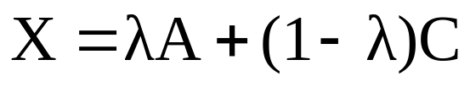
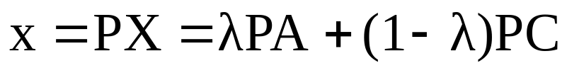
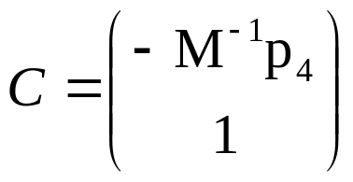
Camera center
null-space camera projection matrix
For all A all points on AC project on image of A,
therefore C is camera center
Image of camera center is (0,0,0)^{T}, i.e. undefined
Finite cameras:
Infinite cameras:

Slide 13
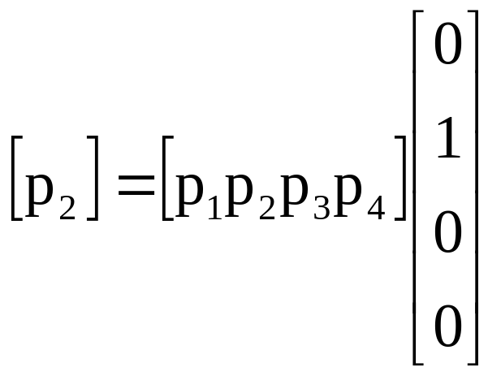
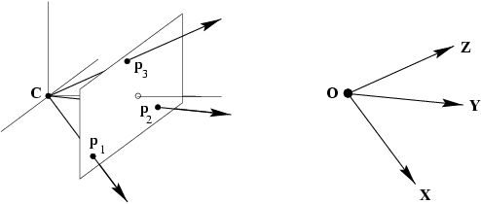
Column vectors
Image points corresponding to X,Y,Z directions and origin

Slide 14
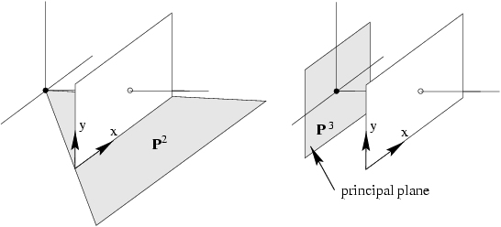
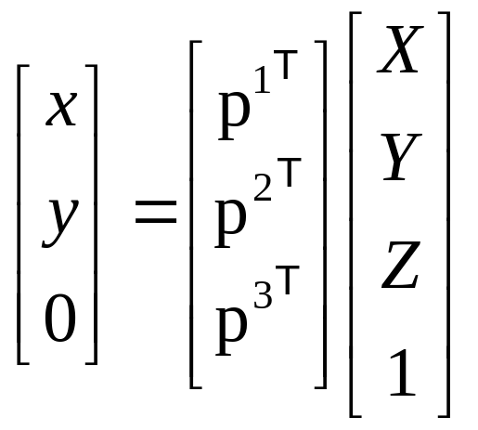
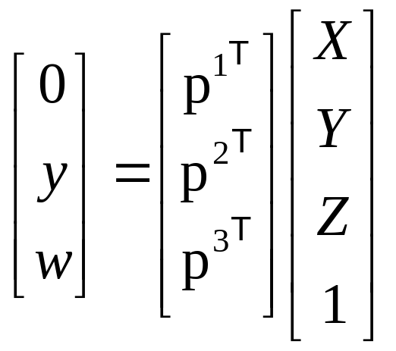
Row vectors
note: p¹,p² dependent on image reparametrization

Slide 15

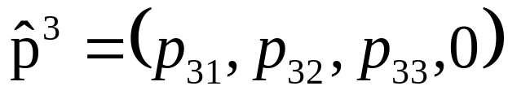
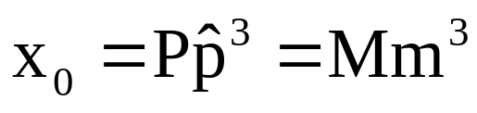
The principal point
principal point

Slide 16
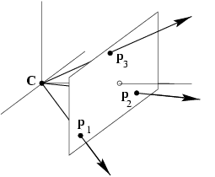

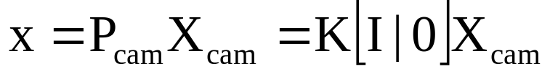
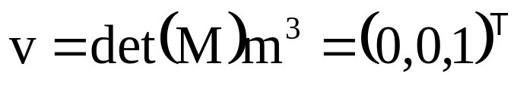
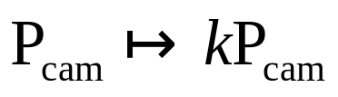

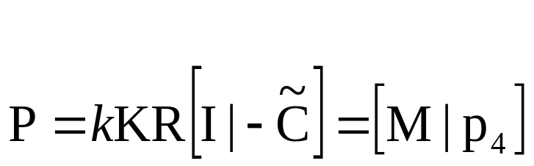
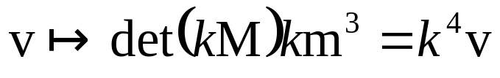

The principal axis vector
vector defining front side of camera
(direction unaffected)
because

Slide 17
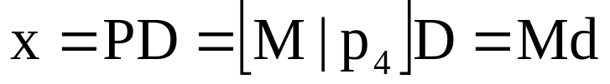


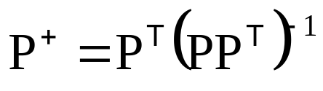

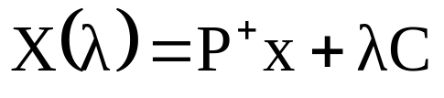




Action of projective camera on point
Forward projection
Back-projection
(pseudo-inverse)

Slide 18





Depth of points
(PC=0)
(dot product)
If ,
then m³ unit vector in positive direction

Slide 19






Camera matrix decomposition
Finding the camera center
(use SVD to find null-space)
Finding the camera orientation and internal parameters
(use RQ decomposition ~QR)
(if only QR, invert)
=( )⁻¹= ⁻¹ ⁻¹
Q
R
R
Q

Slide 20

When is skew non-zero?
arctan(1/s)
1
γ
for CCD/CMOS, always s=0
Image from image, s≠0 possible
(non coinciding principal axis)
resulting camera:

Slide 21


Cameras at infinity
Camera center at infinity
Affine and non-affine cameras
Definition: affine camera has P^{3T}=(0,0,0,1)

Slide 22



Affine cameras

Slide 23



Affine cameras
modifying p₃₄ corresponds to moving along principal ray

Slide 24


Affine cameras
now adjust zoom to compensate

Slide 25








Error in employing affine cameras
point on plane parallel with principal plane and through origin, then
general points

Slide 26

Affine imaging conditions
Approximation should only cause small error
Δ much smaller than d₀
Points close to principal point
(i.e. small field of view)

Slide 27




Decomposition of P∞
absorb d₀ in K_{2x2}
alternatives, because 8dof (3+3+2), not more

Slide 28


Summary parallel projection
calibration matrix
principal point is not defined

Slide 29



(5dof)
Scaled orthographic projection
(6dof)

Slide 30


A hierarchy of affine cameras
Weak perspective projection
(7dof)

Slide 31



A hierarchy of affine cameras
Affine camera
(8dof)
Affine camera=camera with principal plane coinciding with Π∞
Affine camera maps parallel lines to parallel lines
No center of projection, but direction of projection P_{A}D=0
(point on Π∞)

